Slide 1
Science Equipment

Slide 2
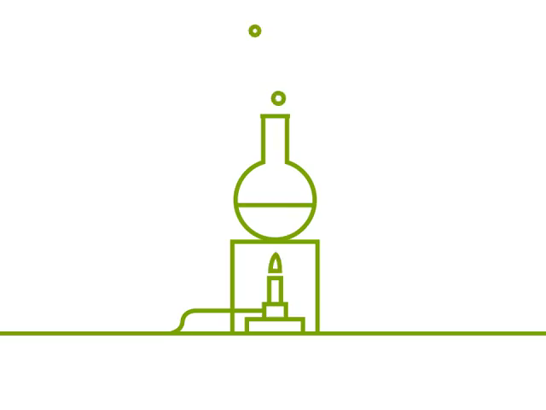
By the end of this lesson you should be able to:
Name and describe the equipment used to contain and measure liquids.
Name and describe the equipment used to heat substances.

Slide 3
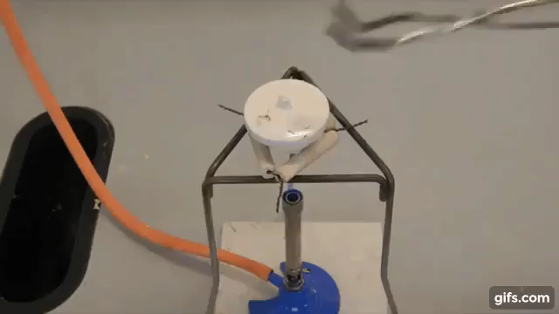
In this Smart Lesson, we're going to look at the equipment used in modern laboratories to do experiments.
Scientific experiments need to be precise, controlled and safe. This means that specific equipment is required to carry them out, you can't just use your hands!

Slide 4
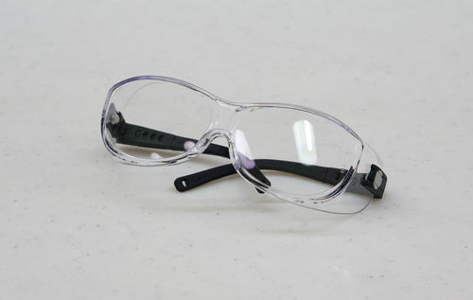
Safety glasses are the most important piece of science equipment.
Safety glasses protect your eyes from dangerous materials, such as chemicals and shards of glass.
They should be worn at all times when doing experiments.

Slide 5
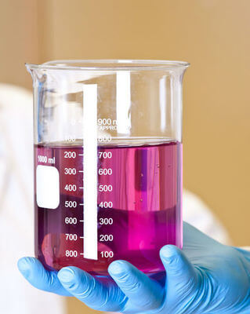
This is a beaker, a classic piece of equipment.
Beakers are round glass containers used for holding, stirring, mixing and heating up liquids. They come in different sizes and are fragile so be careful when using them.

Slide 6
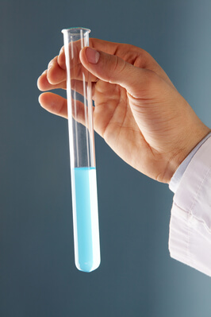
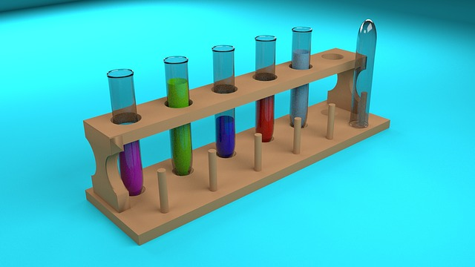
Test tubes are also very handy pieces of glassware.
Test tubes are smaller than beakers and are used for holding and mixing small amounts of liquid. You can also use them to heat up substances and make them react - more on that later.
A test tube rack is a wooden frame that can hold multiple test tubes. It's useful for when you already have both hands full.

Slide 7
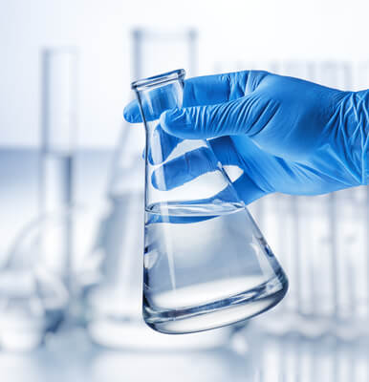
This is a conical flask.
It is used for many of the things that beakers are used for. Its narrow neck means the liquid inside can be swirled around without spilling out or evaporating. However, you usually need a funnel in order to fill it.

Slide 8
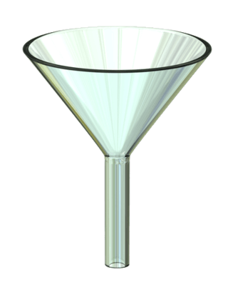
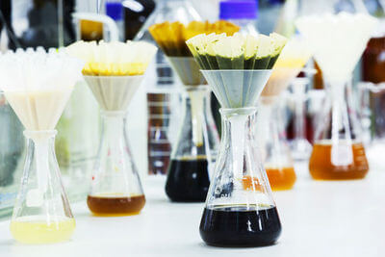
A funnel is a cone-shaped instrument that lets you pour liquids into a small hole, like the top of a conical flask.
Funnels in the lab are made of glass or plastic. They are also used with filter paper to separate solids from liquids.

Slide 9
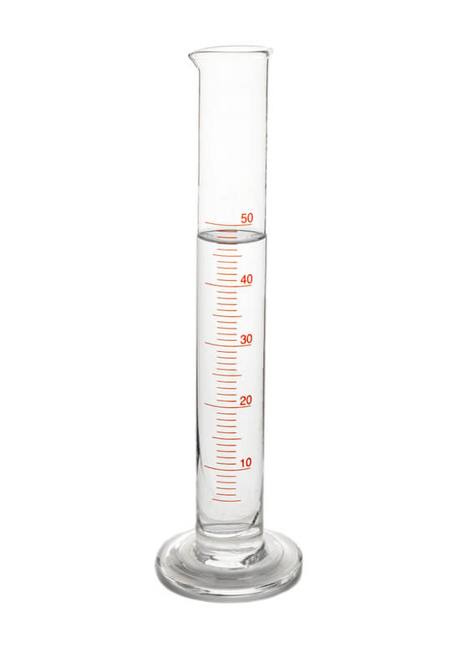
Finally, we have the measuring cylinder.
As the name implies, it is a cylinder designed for accurately measuring liquids. The markings on the side allow you to see the volume of liquid - how much is inside. The numbers on this cylinder represent millilitres (mL) which is a common measurement of volume.

Slide 10
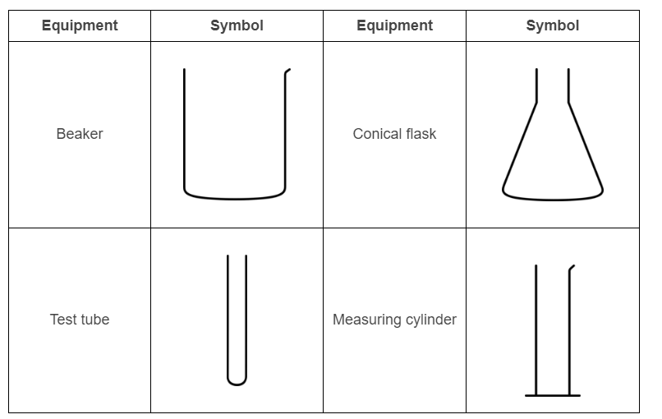
Scientists often need to draw diagrams showing how they use their equipment.
However, it would take too long to draw an accurate picture of every beaker and flask, so they use symbols instead.
Here are the symbols used for the holding and measuring equipment you just saw:

Slide 11
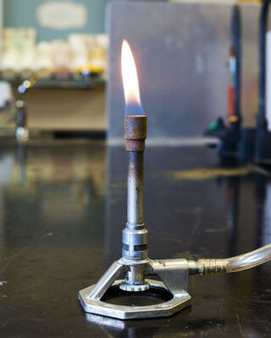
Many experiments require substances to be heated up.
To do this, laboratories are equipped with Bunsen burners. A Bunsen burner is a gas-powered device that sits on a bench or desk and produces a small flame. This flame can be used to heat anything you hold above it.

Slide 12
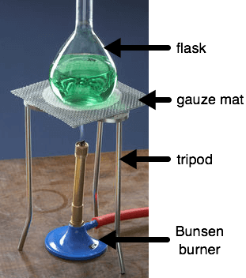
It's a good idea to use a metal tripod to support things above a Bunsen burner.
That way, you don't have to hold onto your beakers and flasks while you heat them up.
A gauze mat, or heat proof mat, goes on top of the tripod. This mat is designed to evenly spread out the heat from the Bunsen burner. It means you won't burn your chemicals or melt any equipment.

Slide 13
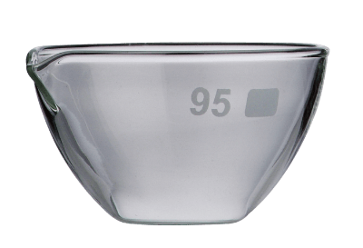
Evaporating dishes are small, shallow bowls that fit nicely on top of a tripod and gauze mat.
As its name suggests, an evaporating dish is great for evaporating liquids.
This is often done to separate out any solids dissolved in the liquid.
For instance, you can use this dish to evaporate the water from sea water, which leaves behind salt crystals.

Slide 14
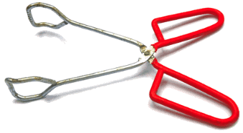
When you need to hold onto something as you're heating it, or take it off the Bunsen burner, you need tongs.
These tongs are designed to fit nicely around a cylindrical object, like a test tube. The red bits on the handles protect your hand from the heat of the Bunsen burner, so you don't get burnt.

Slide 15
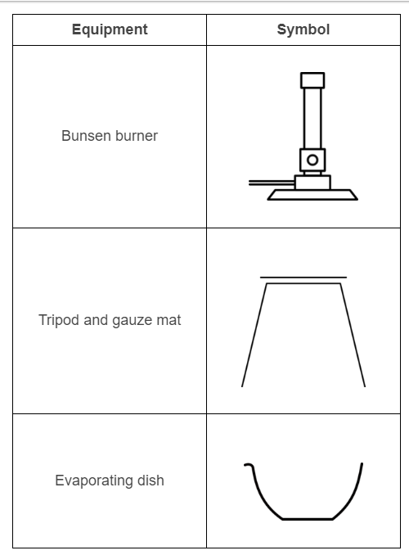
Scientists often need to draw diagrams showing how they use their equipment.
However, it would take too long to draw an accurate picture of every beaker and flask, so they use symbols instead. Again they are drawn in 2-D with no shading.
Here are the symbols used for the heating equipment you just saw:

Slide 16
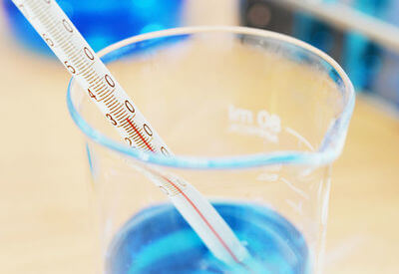
Thermometers are used to measure temperature.
Scientific thermometers are made out of glass and are very fragile, so you need to be careful not to break them. Do not use thermometers to stir mixtures.

Slide 17
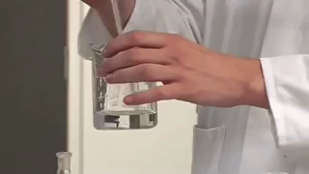
A stirring rod is used to combine mixtures.
It is usually made out of thick plastic so that it doesn't break.

Slide 18
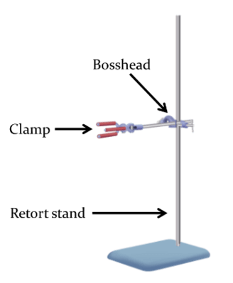
A retort stand with boss head and clamp is used to hold equipment at a specific height.
The boss head and clamp are often stored separately and need to be attached to the retort stand.

Slide 19
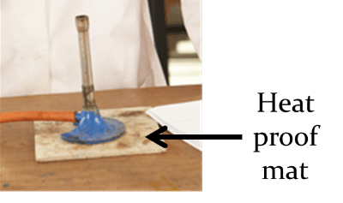
A heatproof mat is used to protect the tabletop during high-temperature experiments, such as when using a Bunsen burner.

